Slide 1
LaMoure County SCD
Arboretum Project

Slide 2
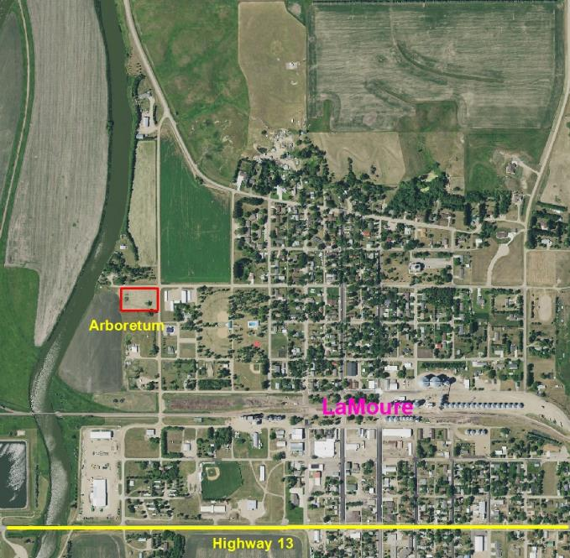
Started late fall 2017
Don and Mary Lou Gentzkow wanted to donate 2 acres of hayland to the LaMoure Soil Conservation
Can we accept this?
Will it get used?
Can we afford this?
Does it fit with our goals?
Can we use funding for this?

Slide 3
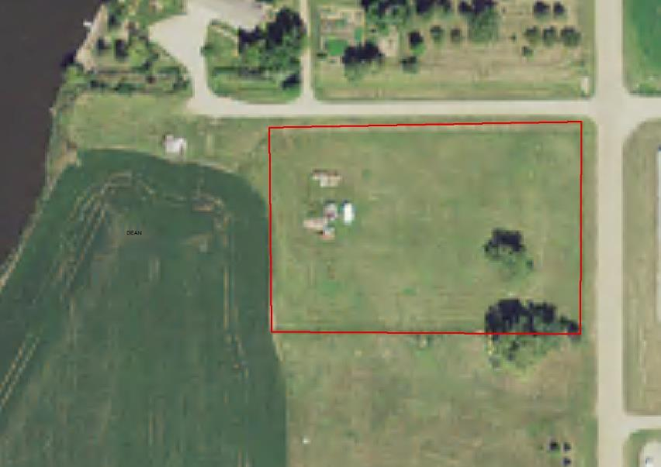

Slide 4
Design????
Add features?
mounds?
edging?
Walking path?
Deer fence?
Handicap accessible?
Dig a well?
Hire an architect?

Slide 5
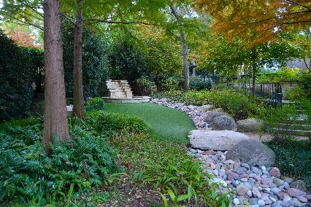
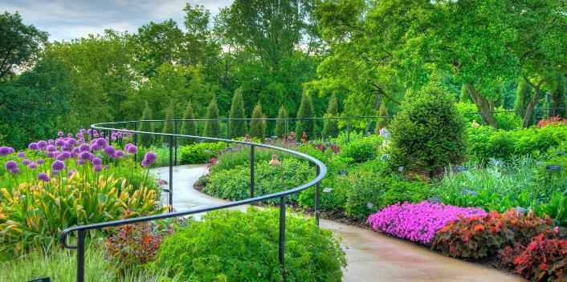

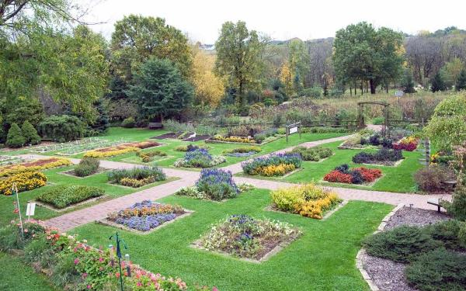
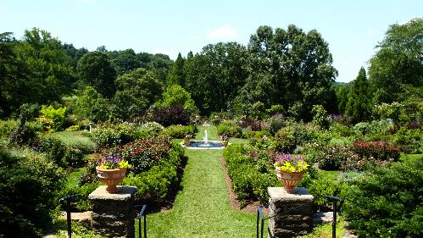

Slide 6
K.I.S.S. Method
Keep
It
Simple
Stupid!

Slide 7
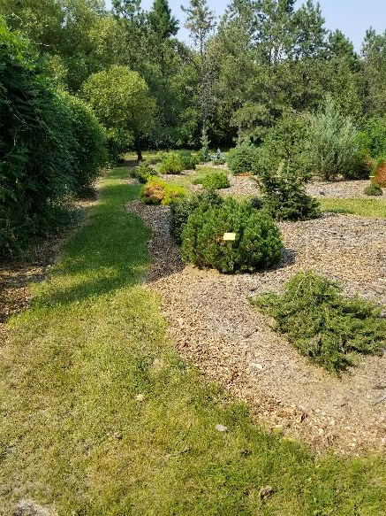
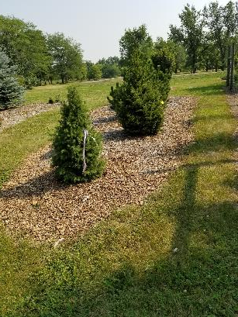
Arboretum
at Absaraka

Slide 8
Decisions
Add features?
mounds?
edging?
Walking path?
No
No
Deer fence?
No
Dig a well?
Handicap accessible?
Hire an architect?
No
No
No

Slide 9
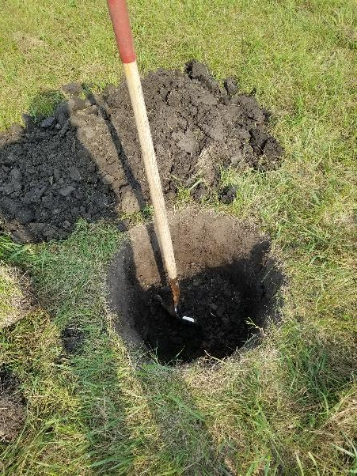
August 2018
We finally just grabbed a shovel!

Slide 10
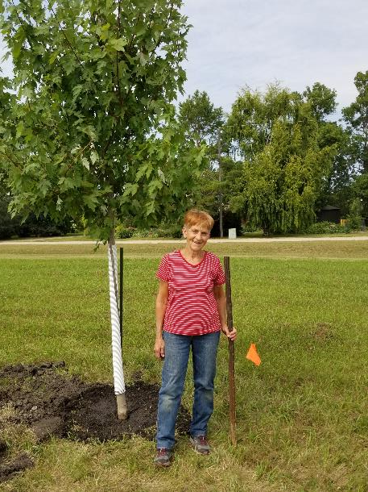
Mary Lou Gentzkow

Slide 11
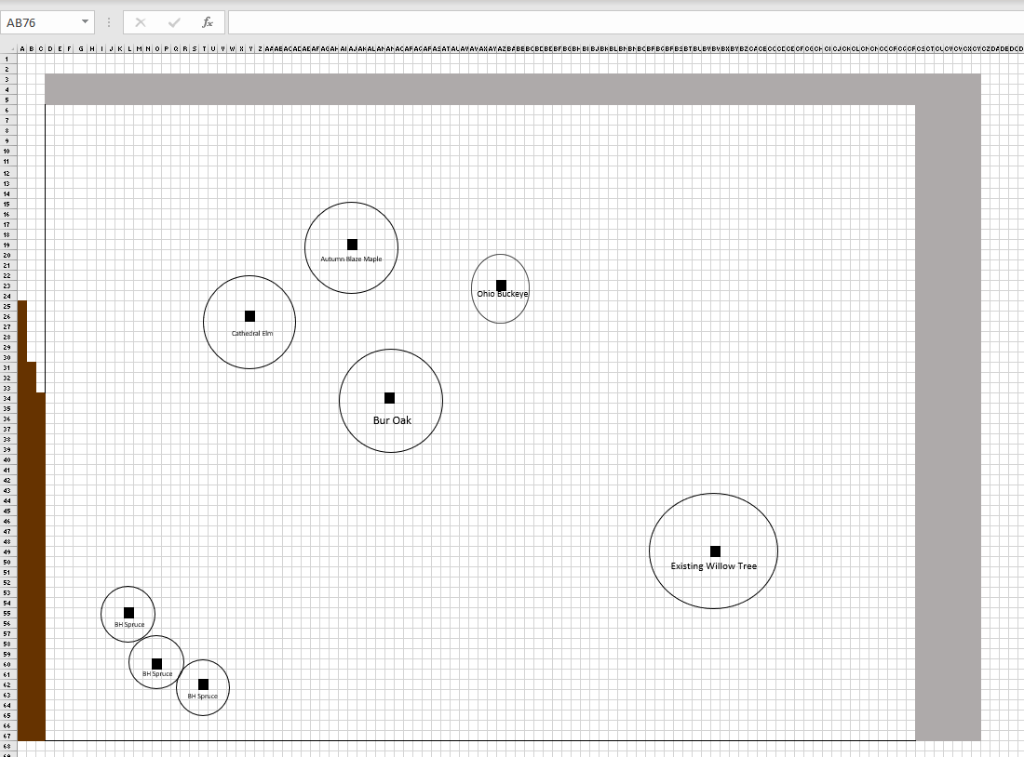
7 trees
planted
fall 2018

Slide 12
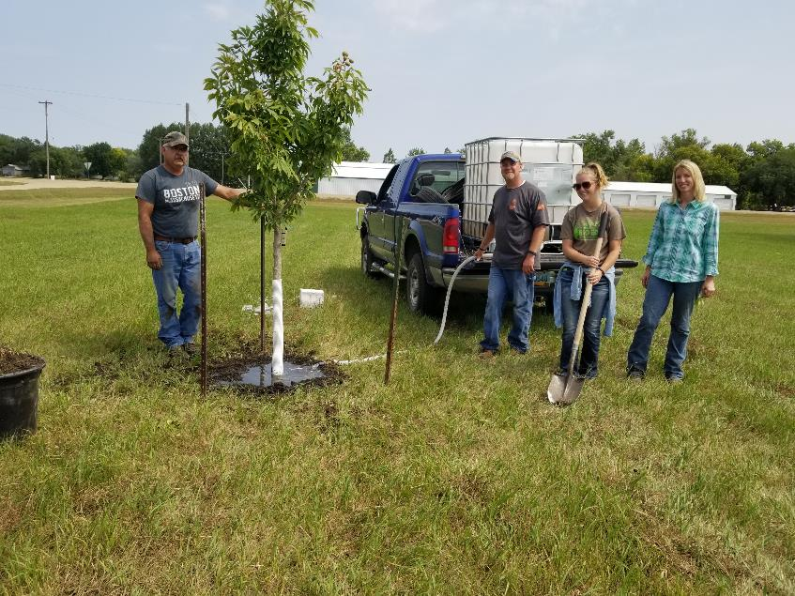

Slide 13
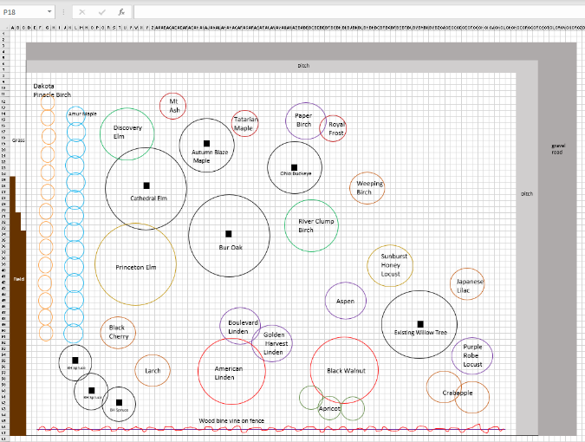
Sue’s Design
I wanted to know exact property line so I didn’t plant trees too close to the field.
This space left for the unusual horticultural plants
Climbing vine for privacy from property owner to the south

Slide 15
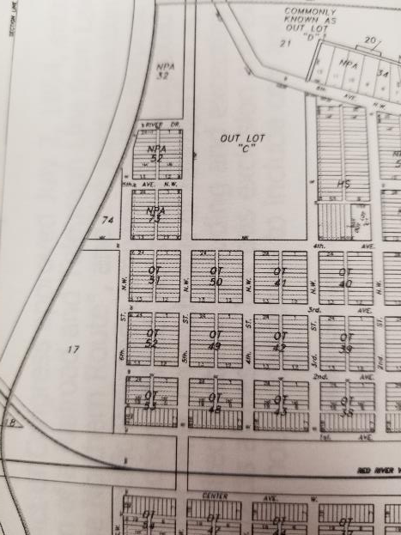
A little wrench in the plan…

Slide 16
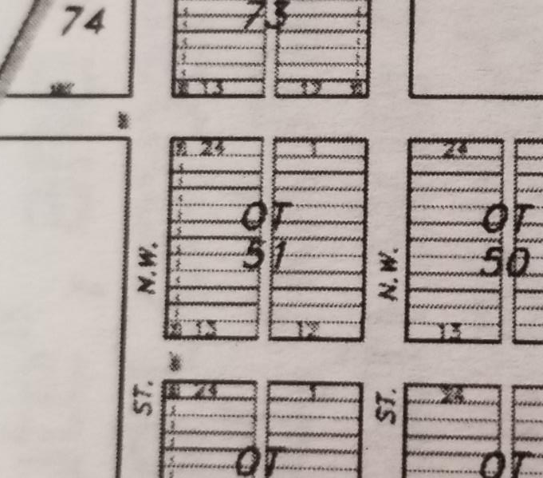
We own lots 1-12
And
13-24

Slide 17
NOT the
Alley and
The roadway
Roadway
Alley

Slide 18

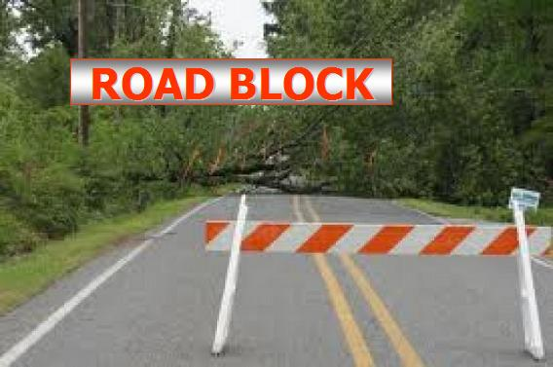
TORDON!!!!

Slide 19
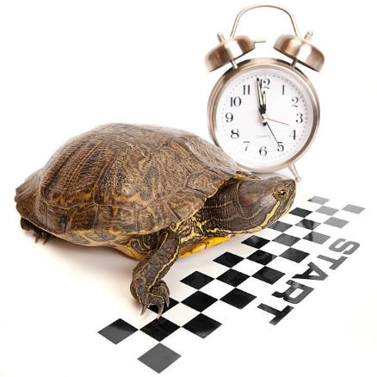
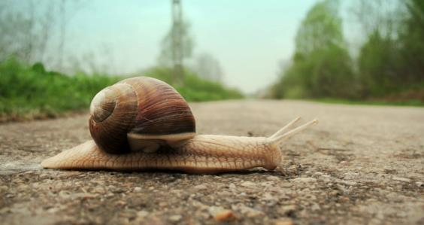
Took Soil tests… expensive
results: no tordon found

Slide 20
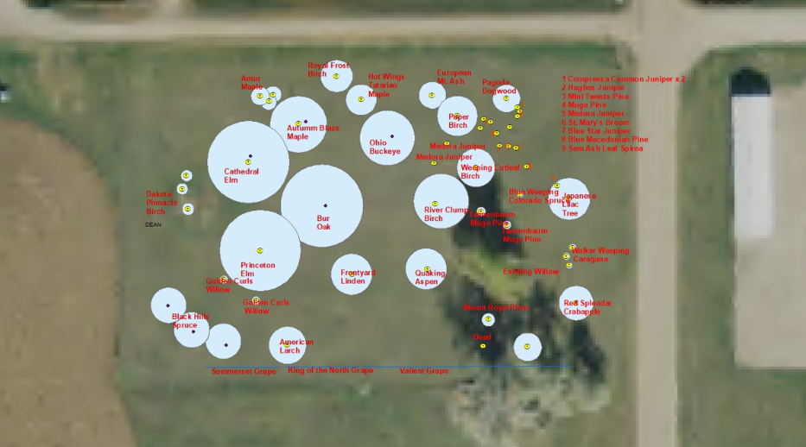
20 trees
planted
spring 2019

Slide 21
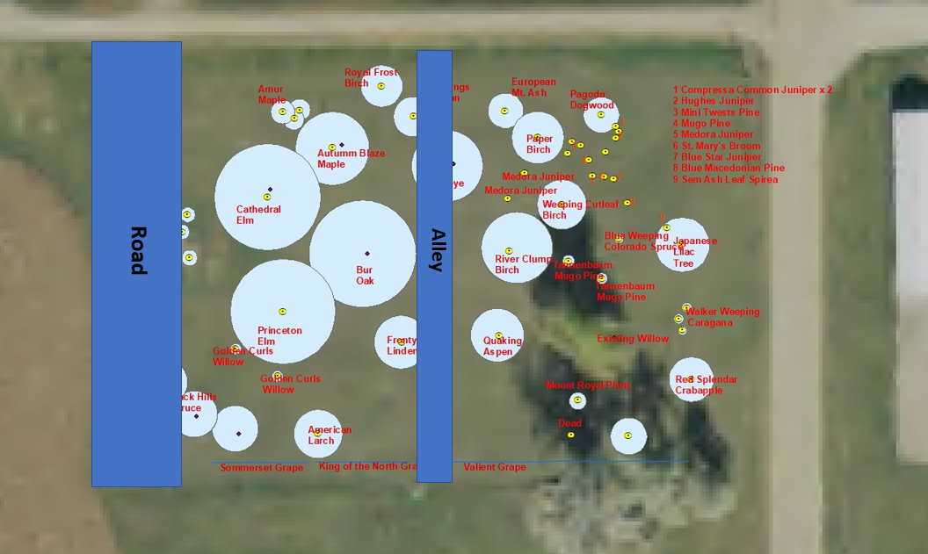
Roadway could be a tallgrass wildflower patch.
Also good to have buffer from crop spray

Slide 22
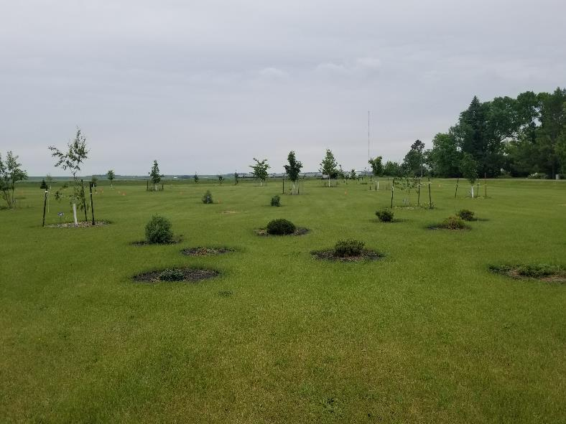

Slide 23
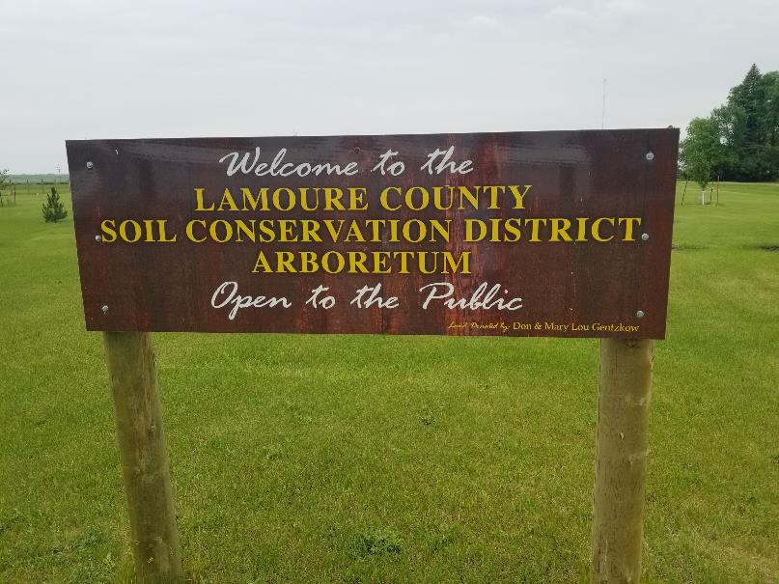

Slide 24
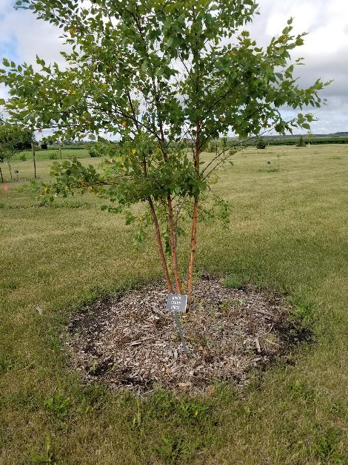

Slide 25
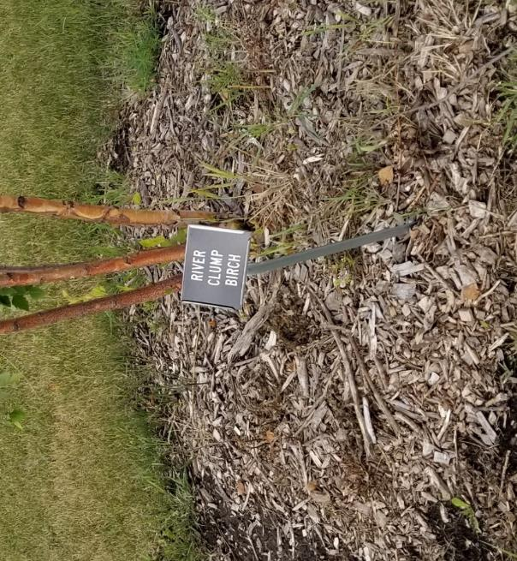
Signs purchased from Newman Signs in Jamestown,
Holders ordered online

Slide 26
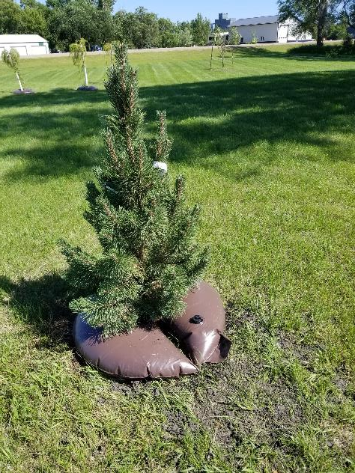
Watering bags
Holds 15 gallons

Slide 27
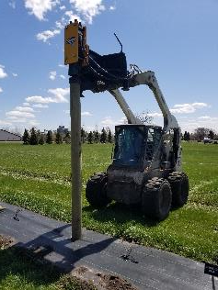
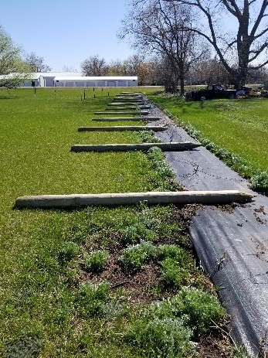
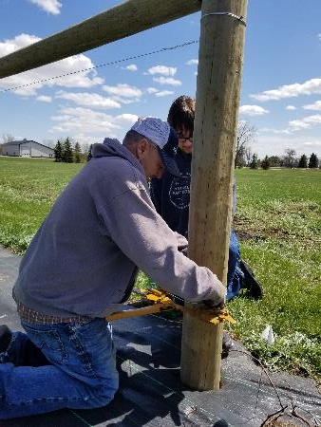
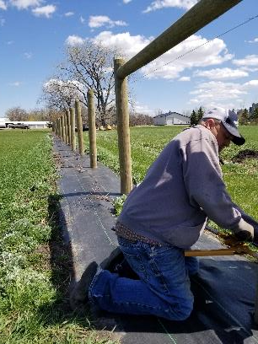

Slide 28
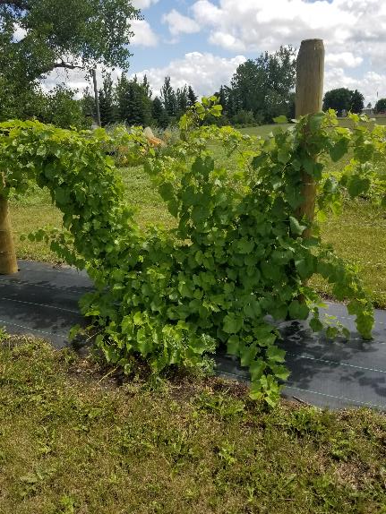
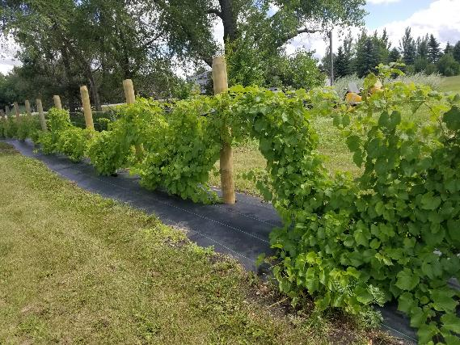

Slide 29
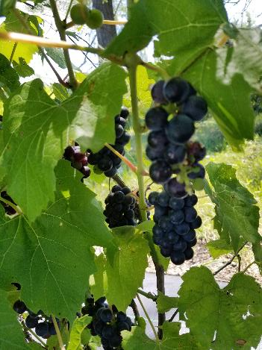
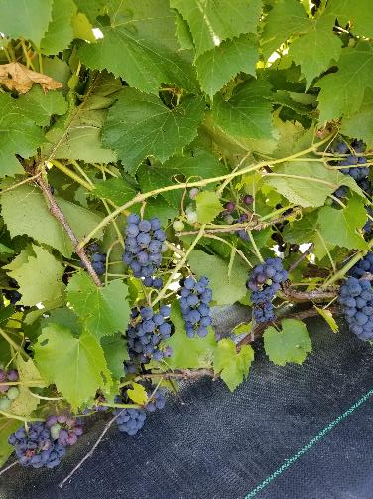
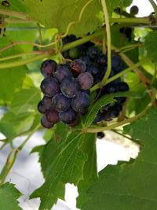
LOTS
of grapes
by the
second
year!

Slide 30
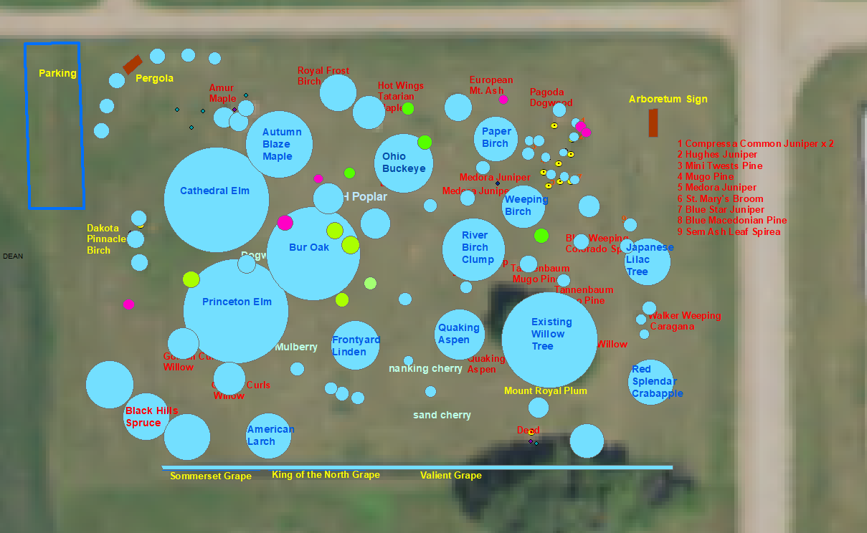
By 2020
There are
70 trees,
Shrubs,
Wildflowers, and grasses
(and I gave
Up on avoiding the road and alley)

Slide 31


At this point, things are looking good but there are
A few issues…

Slide 32
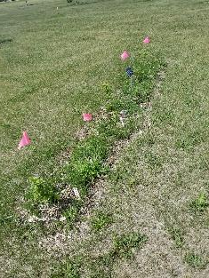
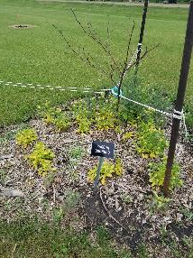
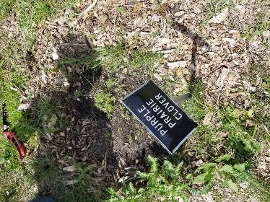
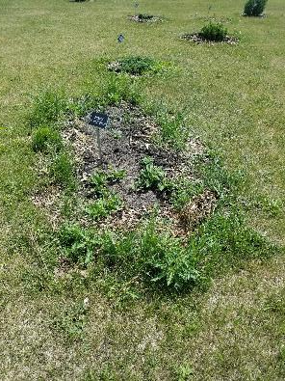
Maintenance needed!

Slide 33
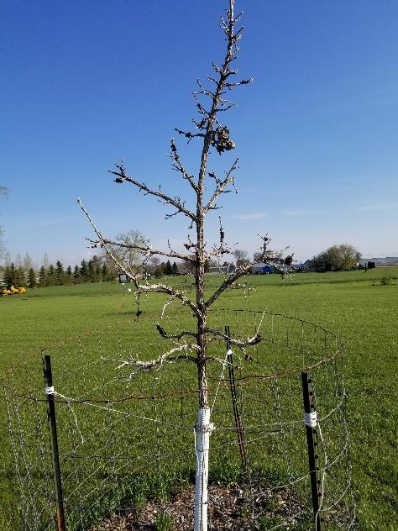
Gall thingy on oak tree

Slide 34
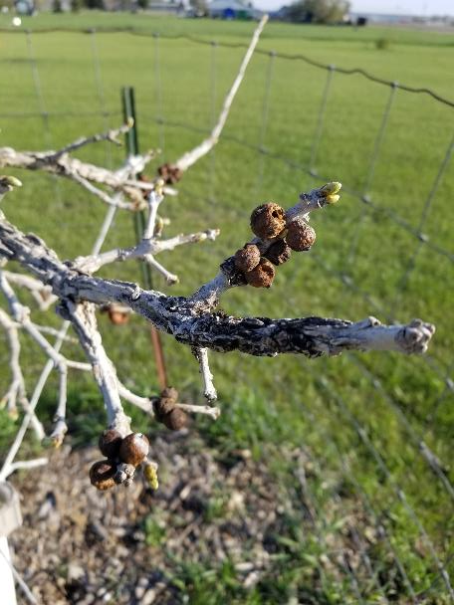

Slide 35
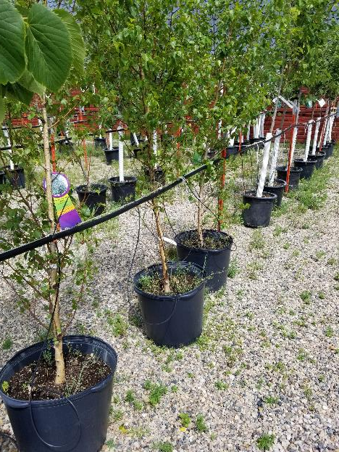
Some species I can only get in potted stock

Slide 36
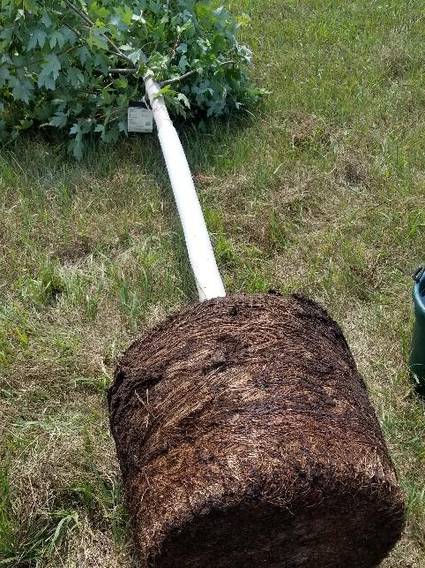
Which leads to circling roots

Slide 37
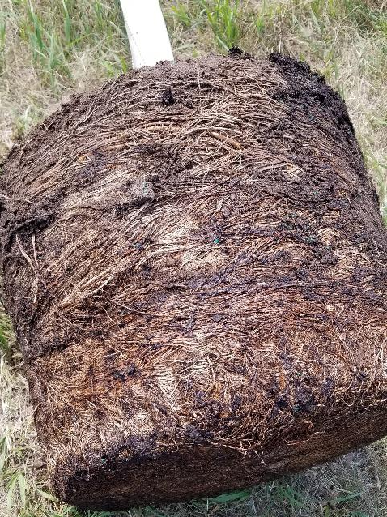

Slide 38
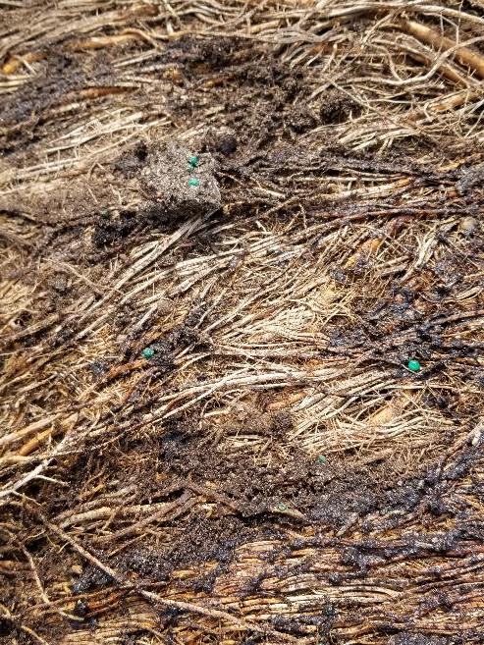

Slide 39
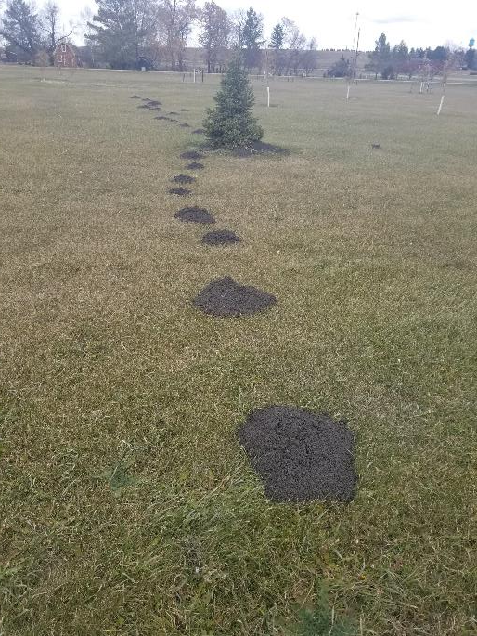

Pocket gophers
Pocket gophers

Slide 40
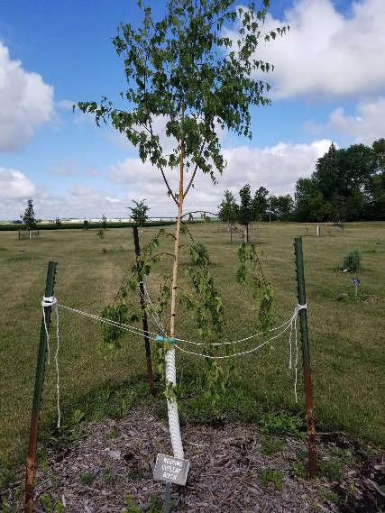
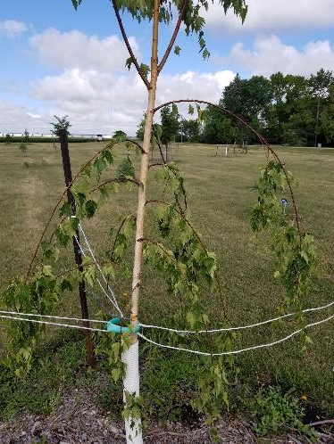

Why so droopy?

Slide 41
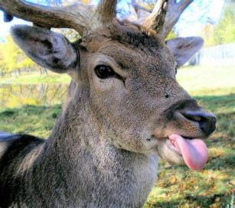
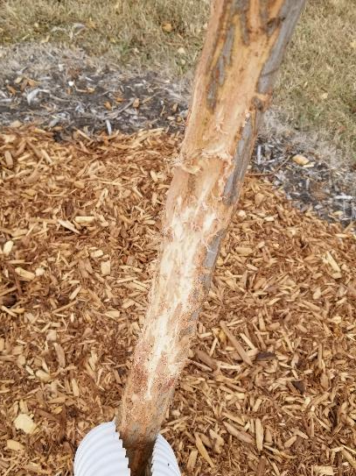


Deer damage
Sorry
Not

Slide 42

Remedy:
We needed someone to help with maintenance
Pergola

Slide 43


Slide 44



Slide 45




Slide 46




Slide 47
Budget:
2018 Abstract 905
permit 10
7 trees 1088
sprayer 53
soil testing 448
record at courthouse 20
land tax 14
2019 grapes 158
watering bags etc 274
15 grapevines, 31 trees 2000
mow 525
grape fence 977
2020 stakes for signs 457
welcome sign 300
other signs 224
15 shrubs 250
mulch 279
bench 150
pergola 318
mulch 562
Total: 9500
2021 mowing ?
plants 500
Summary:
plants: 3500
transfer land 950
signs 1000
mowing 1000
bench, pergola 470
soil testing 450
mulch, fence, watering
2145
Total: 9500

Slide 48



Future plans:
A few more shrubs
Geocache site
Picnic table?
Maintain what we’ve got
Ongoing maintenance
Will it get used
Does it comply with our mission statement

